Slide 1
Simple app with MongoDB backend and React FrontEnd
Hugo Pelayo and Guillermo Quintanar

Slide 2
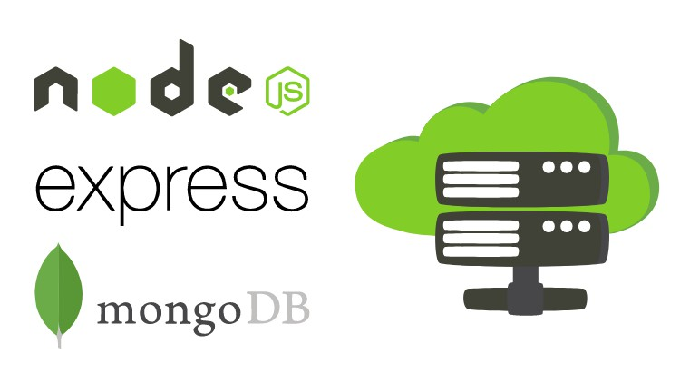
Backend

Slide 3

mongoDB

Slide 4
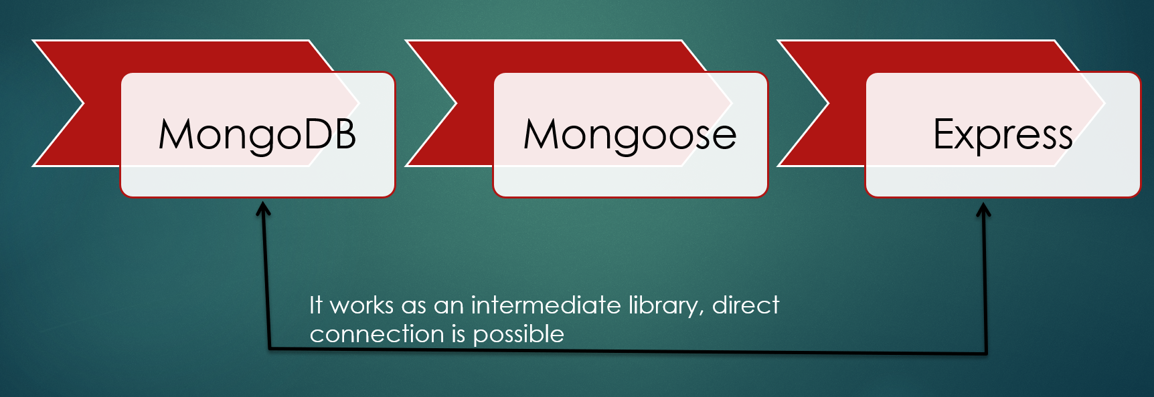
Mongoose

Slide 5
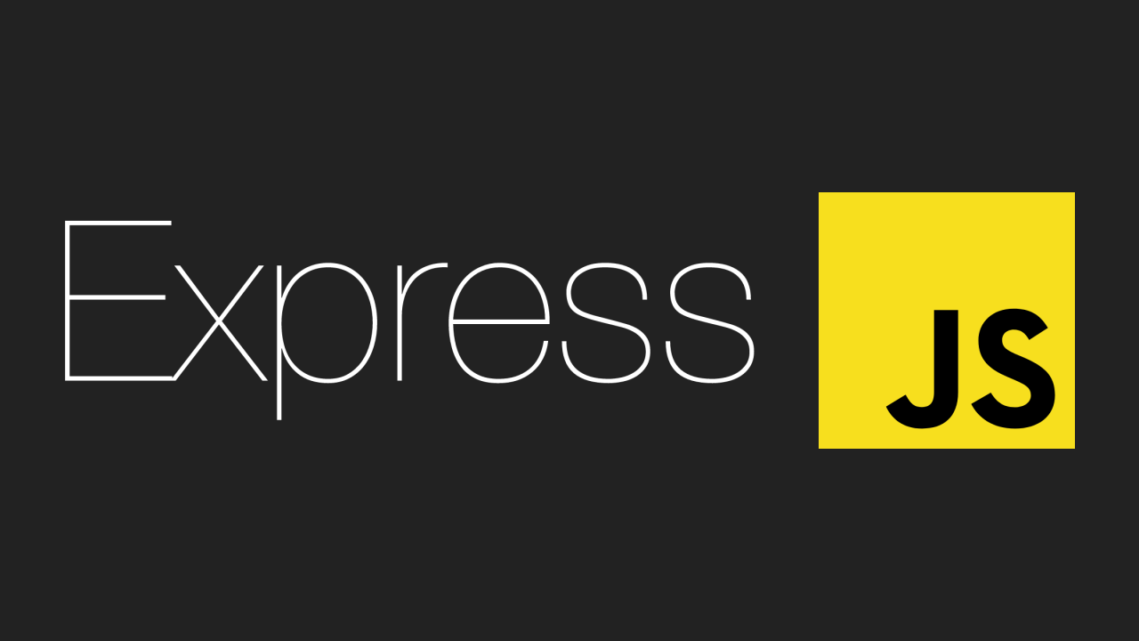
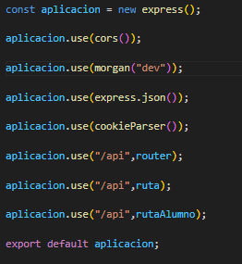
Express

Slide 6


Cookies
Bcrypt

Slide 7



Frontend Tech

Slide 8
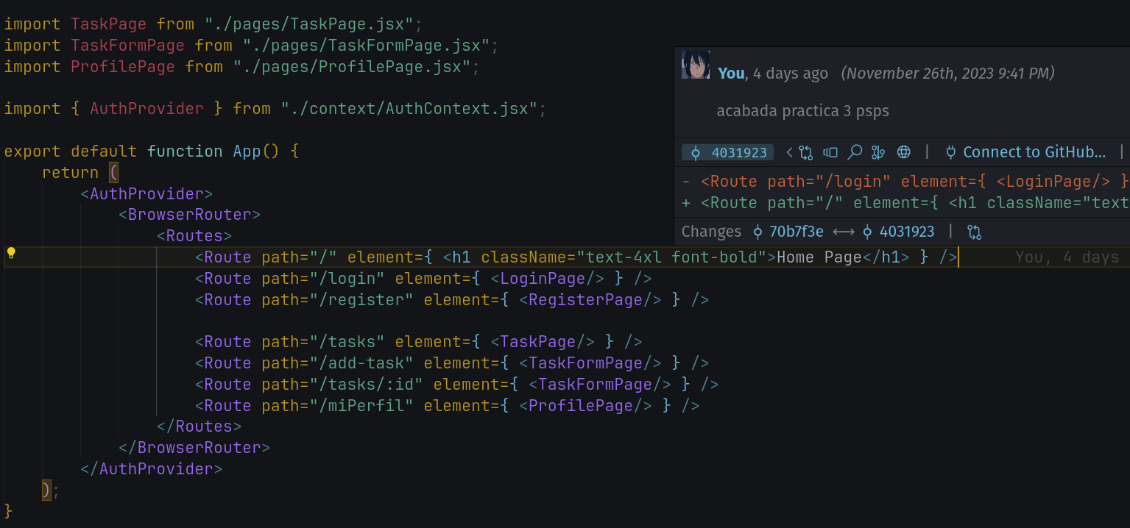
Specify the sites for our routes

Slide 9
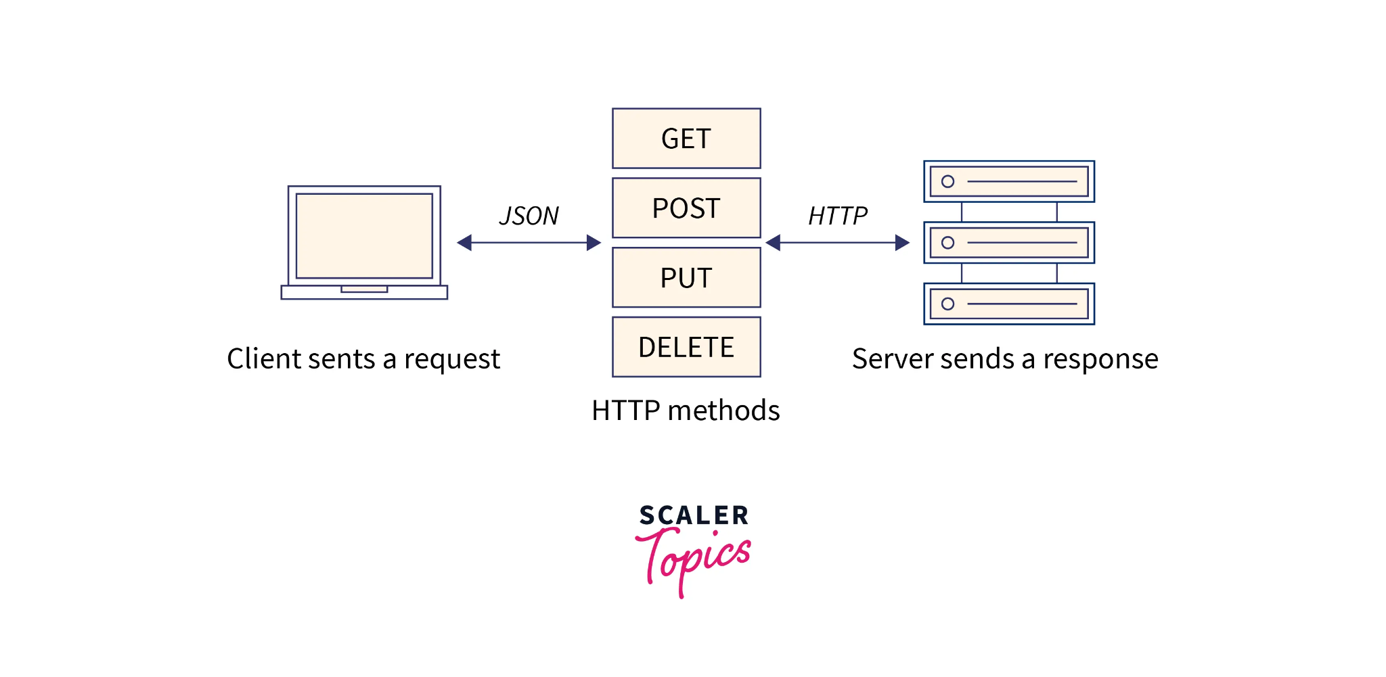
Now we need to send the data from our frontend to our backend.
We use axios for this, but there’s a built-in alternative in the browser (fetch).

Slide 10
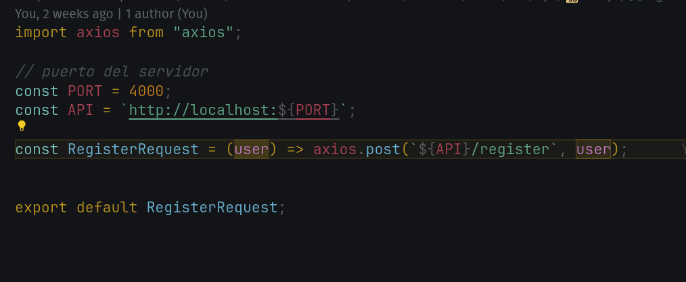

Slide 11
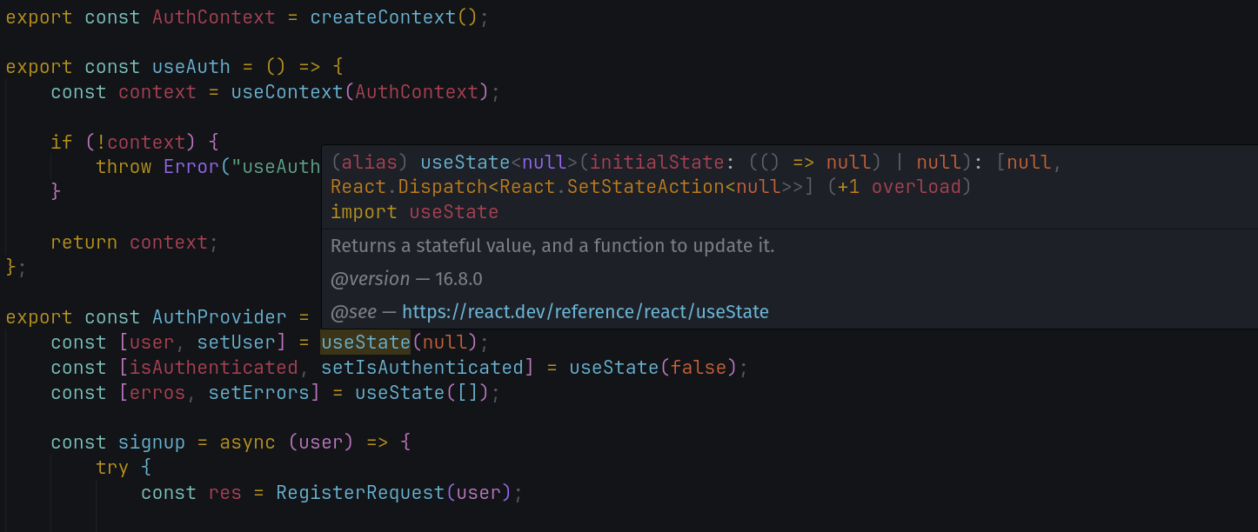
To manage our frontend context we use providers, which are functions that pass data to the different components of our app.

Slide 12
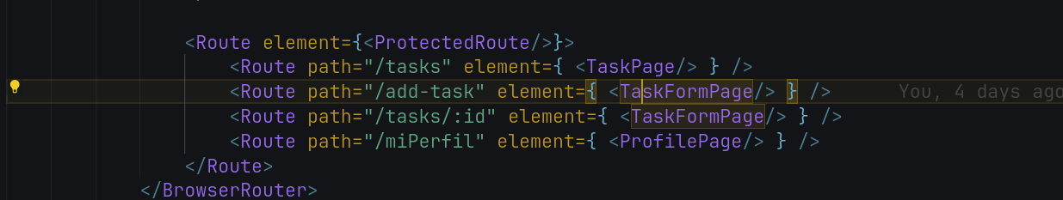
Finally we just need to secure our routes

Slide 13



